Slide 1
Electrify Everything! Joe Straley
Making everything run on electricity is a necessary step in the transition from fossil fuels. Starting that process immediately is also necessary, and helpful both to the process and the environment.

Slide 2
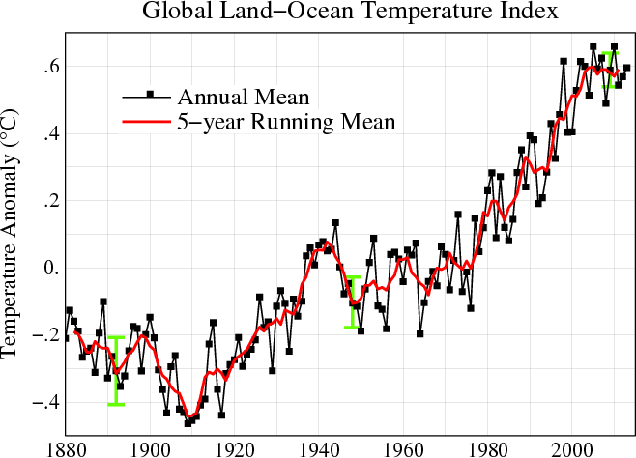
Is the temperature increasing? (2010)

Slide 3
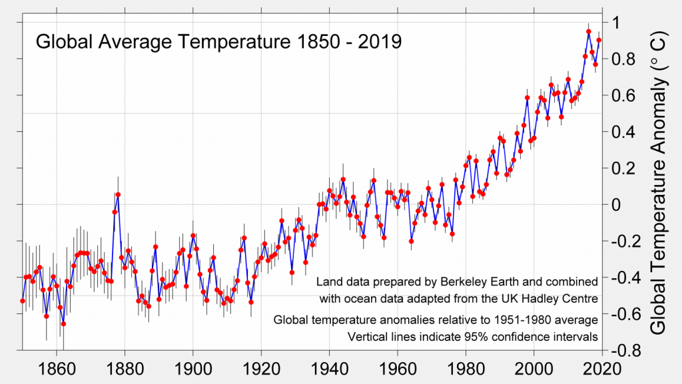
The earth’s temperature is increasing

Slide 4
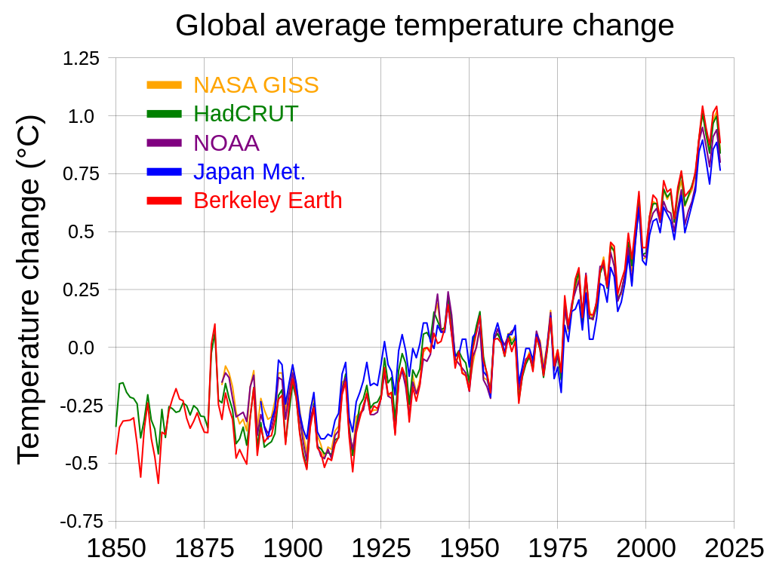
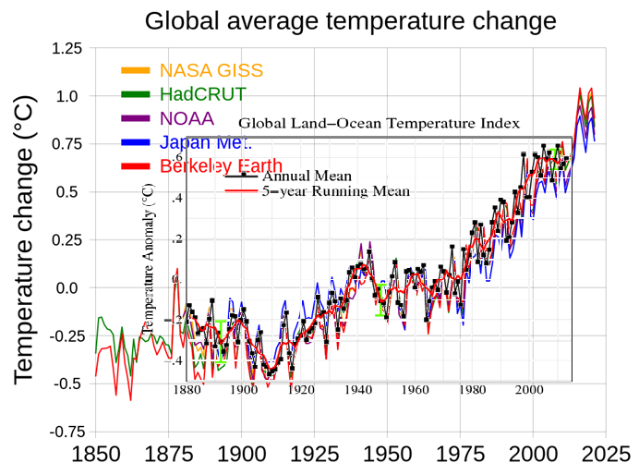
Global Warming is Happening
By RCraig09 - Own work, CC BY-SA 4.0, https://commons.wikimedia.org/w/index.php?curid=88535596

Slide 5
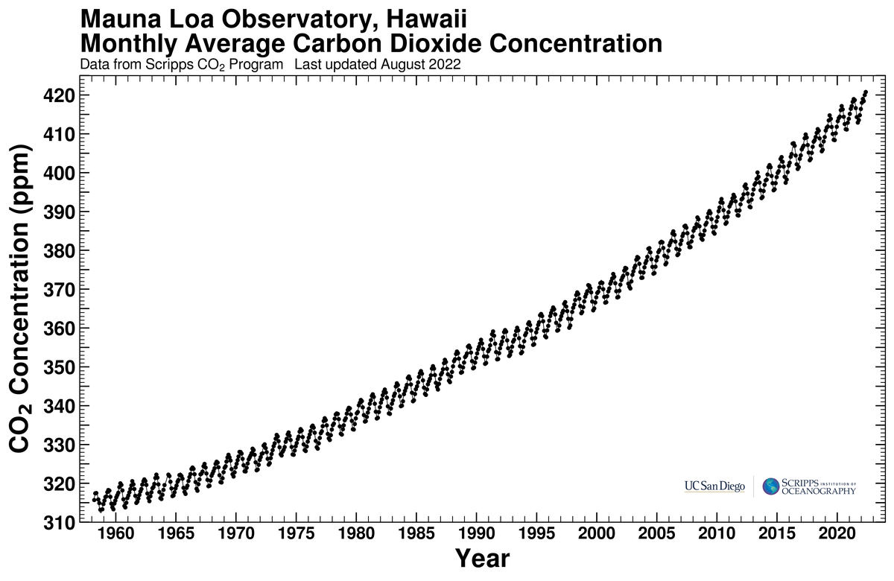
And we know why
C. D. Keeling, S. C. Piper, R. B. Bacastow, M. Wahlen, T. P. Whorf, M. Heimann, and H. A. Meijer

Slide 6
We need to move away from fossil fuels
To prevent future warming
To prevent ocean acidification
For energy security
For better air quality
Small particles
Heavy metals
Acid rain

Slide 7
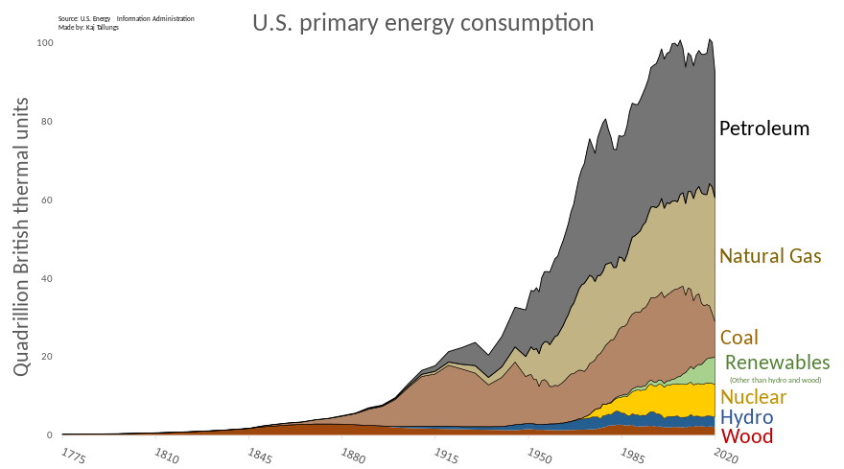
Where energy comes from now

Slide 8
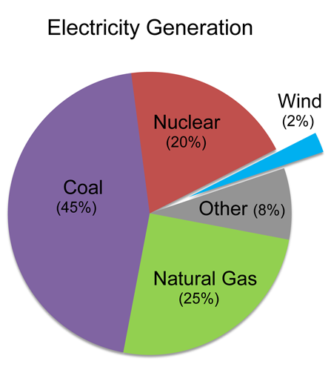
How to get from here to there:
Nuclear power
Wind power
Solar power
Hydropower
Minor resources
(geothermal, … , nuclear fusion)
How soon can these replace fossil fuels?

Slide 9
How to get from here to there:
Nuclear power
Wind power
Solar power
Hydropower
Minor resources
(geothermal, … , nuclear fusion)
How soon can these replace fossil fuels?

Slide 10
How to get from here to there: Nonfossil power is electrical power
Nuclear power
Wind power
Solar power
Hydropower
Minor resources
(geothermal, … , nuclear fusion)
How soon can these replace fossil fuels?

Slide 11

Saul Griffiths

Slide 12



Slide 13
Electrify everything now!
To be ready when the nonfossil resources come online
The lifetime of stoves, furnaces, water heaters, cars, ... range from 5 to 25 years. Electrify now to avoid this source of inertia

Slide 14
Electrify everything now!
To be ready when the nonfossil resources come online
The lifetime of stoves, furnaces, water heaters, cars, ... range from 5 to 25 years. Electrify now to avoid this source of inertia
The Nonfossil Energy Future is an Electrical Future

Slide 15
Electrify everything! Advantages
Central power plant conversion of fossil fuels to electrical energy is the most efficient method
Combined-cycle gas 50-60%
Coal-fired power 33%
Gasoline automobile engine 20%
Diesel engine 40%
Electric car 85% (battery energy into motion)
Running an electric car on coal plant electricity is more efficient than a gasoline power car: 85% x 33% > 20%

Slide 16
Electrify everything! Advantages
Conversion of as many power uses to electricity builds the grid and makes the energy economy “renewable ready.”
Provide demand for more electricity.

Slide 17
Electrify
Furnaces and water heaters → heat pumps
Cooking with electricity
Transportation → electric car
Electrical devices often use the energy more efficiently.

Slide 18
Home heating and water heating
A furnace for a 2,000 sq.ft. house would deliver 100,000 BTU/h = 30 KW.
A corresponding heat pump would need 10 KW if the temperature is 40 F = 5 C but significantly more on the days that it is 10 F = - 10 C.
Heat pump water heaters are more economical than gas (they take longer to reheat a whole tankful).

Slide 19
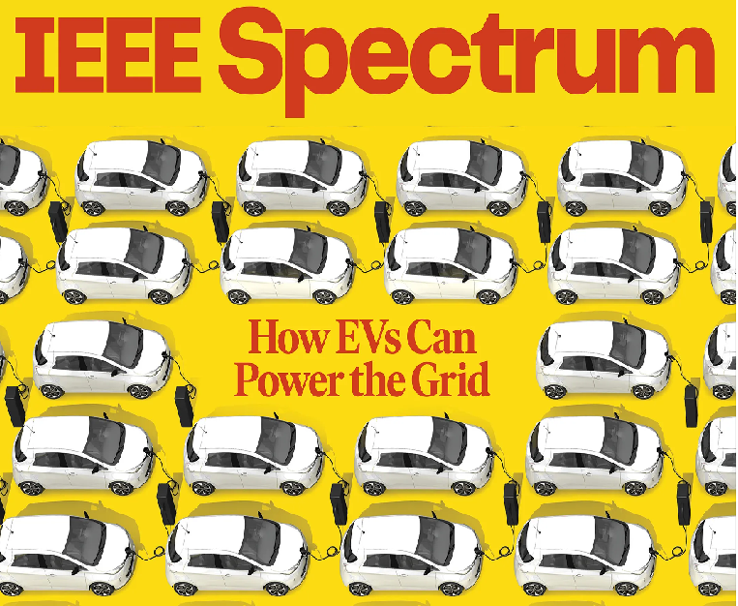

Slide 20
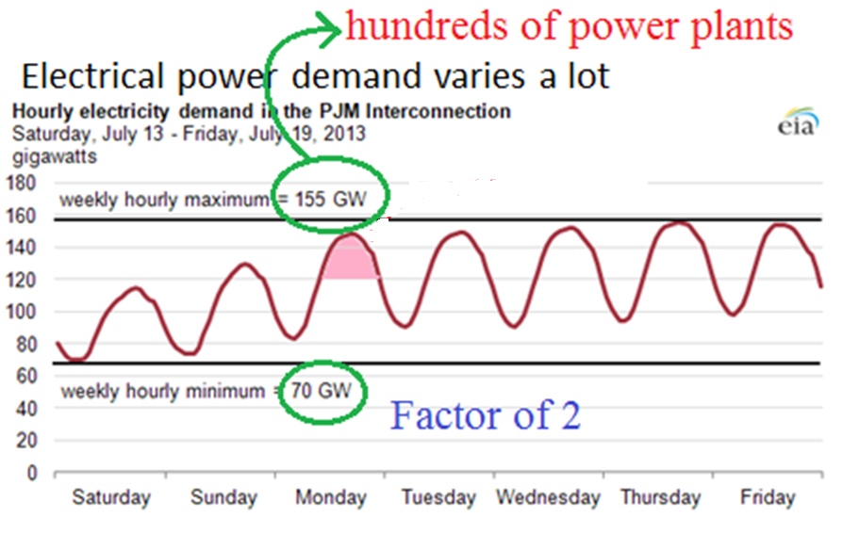

Slide 21
Power the grid?
Load balancing happens a different way

Slide 22
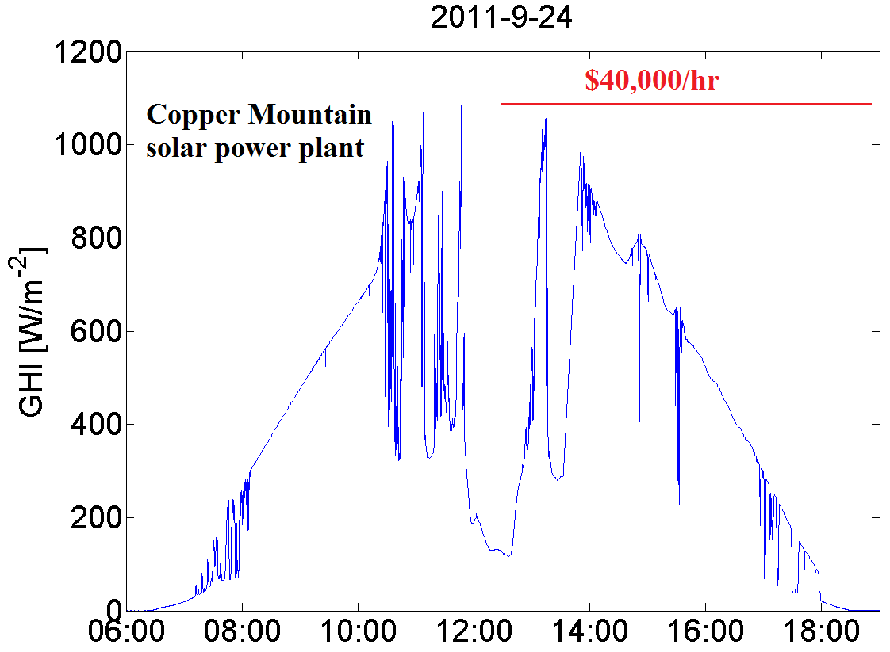
Solar power intermittency

Slide 23
Power the grid?
→ To even out supply and demand fluctuations
Advantages
Provides “inertia” to the grid
Lots of capacity
Widely distributed, tracks population and electrical demand
Disadvantages
The car has to be connected to the grid
The charger has to be reversible
The owner has to agree to this
Despite the large capacity, probably can’t count on a lot of accessible stored energy

Slide 24
Electrical devices are more energy efficient
Energy efficient of gasoline cars is quite low – 20%
Electrification of transportation could decrease energy input by a factor of 4 – and this is 27% of the energy budget
Heat pumps deliver 2-3 times as much energy as is put into them

Slide 25

Where does the electrical power come from?
“US energy use” is 10²⁰ J/year =
= 3.2 x 10¹² Watts
= 3200 Gigawatt
≈ 3200 large power plants !!!
Right now, the total US electrical power output is only 470 GW??

Slide 26
Where does the electrical power come from?
“US energy use” is 10²⁰ J/year =
= 3.2 x 10¹² Watts
= 3200 Gigawatt
≈ 3200 large power plants !!!
Right now, the total US electrical power output is only 470 GW.
But the comparison isn’t right.

Slide 27
Where does the electrical power come from?
“US energy use” is 10²⁰ J/year = 3.2 x 10¹² Watts = 3200 Gigawatt
6% is from renewables (“heat equivalent”)
4% becomes road paving and plastic goods (doesn’t need replacement)
So we “only” need to replace 2900 GW.

Slide 28
Where does the electrical power come from?
“US energy use” is 2900 Gigawatt that needs to be replaced
2900 GW is the energy value of the fuels – the thermal input to power plants. But a lot of it is electricity production (940 GW of thermal energy becomes 470 GW of electricity) or heat used at low temperature (heat pumps can provide that at a big discount) or in inefficient devices (automobiles!).
We only need 1400 Gigawatts of electricity to replace it.

Slide 29
1400 GW!
US nuclear power plants : 96 GW (843,000 GWh/year)
US wind power : 43 GW (380,000 GWh/year) in 2021.
US hydroelectric plants : 30 GW (260,000 GWh/year)
US solar power : 13 GW (115,000 GWh/year) in 2021
Total 182 GW nonfossil energy
Total electrical power 470 GW

Slide 30
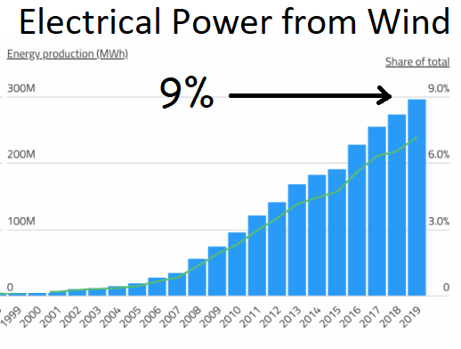
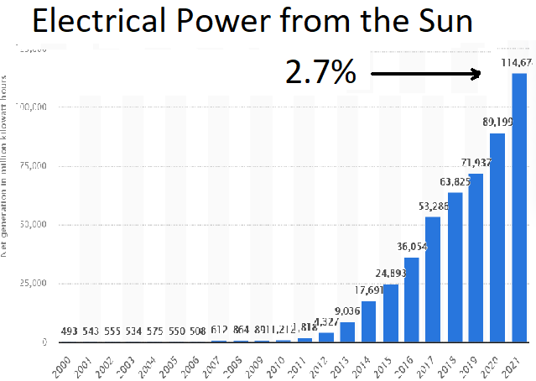
Wind Solar

Slide 31
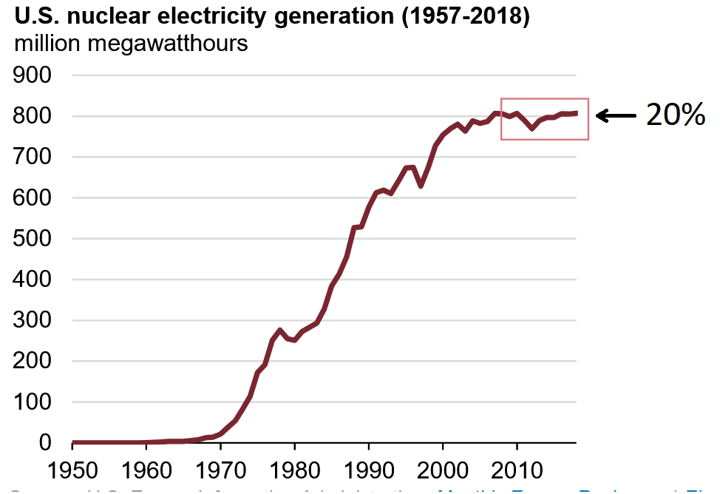

Slide 32
How we’ll get there
High gasoline prices are making electric cars more economical, charge points are appearing all over the place, and they are getting favorable press.
The newly passed Inflation Reduction Act has tax write-offs for heat pumps, solar panels, and electric cars.

Slide 33
Conclusion
Electrifying everything will decrease energy need and CO₂ production, even before the development of nonfossil energy resources
Electrifying everything will be a challenge, but it can be done

